Slide 1
SQL
neonlearn

Slide 2
Sec_1:
Sorting (order by)
IN & BETWEEN
LIKE
REGEXP
IS NULL
LIMIT
Sec_2: (JOIN)
INNER JOIN
Self join
different dataset
three table join
composite primary key
OUTER JOIN
USING
NATURAL JOIN
CROSS JOIN
UNION

Slide 3
Sec_3:
CREATE TABLE
INSERT
Multi-line
Multi-table (LAST_INSERT_ID)
from table to another
UPDATE
Subquerry
DELETE
Sec_4:
AVG, MAX & MIN
SUM, COUNT, GROUP BY
HAVING
ROLLUP
Sec_5:
Where subquery
ALL
ANY
Correlation
EXIST
Select subquery
From subquerry

Slide 4
Sec_6: (functions)
numerical functions
Round, TRUNCATE
CEILING, FLOOR
ABS
RAND
numerical functions
LENGTH
UPPER, LOWER
TRIM, LTRIM, RTRIM
SUBSTRING, LEFT, RIGHT
LOCATE, REPLACE
CONCAT
date & time functions
NOW, CURDATE, CURTIME
YEAR, MONTH, DAY
HOUR, MINUTE, SECOND
MONTHNAME, DAYNAME
EXTRACT
DATE_FORMAT
DATE_ADD, DATE_SUB
DATEDIFF
TIMESTAMPDIFF
TIME_TO_SEC
condition functions
IFNULL
COALESCE
IF
CASE (WHEN, THEN)

Slide 5
Sec_7: (VIEW)
CREATE
CREATE OR REPLACE
DROP VIEW
updateable view
Sec_8: (store procedures)
CREATE PROCEDURE
CALL & DROP PROCEDURE
PROCEDURE with input
PROCEDURE with return
DECLARE (variable)
another example of PROCEDURE
FUNCTION

Slide 6
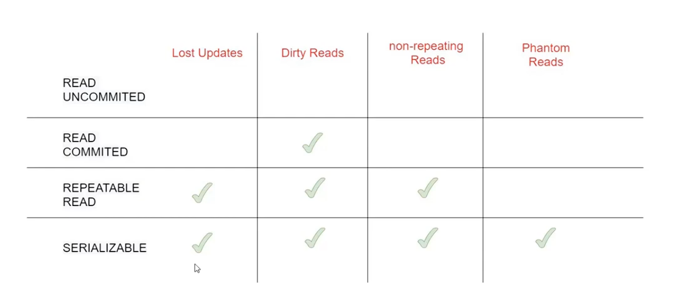
Sec_9:
TRIGGER
CREATE TRIGGER
SHOW & DROP TRIGGER
trigger log
EVENT
ALTER EVENT
enable & disable EVENT
Sec_10: (TRANSACTION)

Slide 7
Sec_11: (Data type)
String
Int
Float
Date
Json
Sec_12: (Database)
CREATE & DROP DATABASE
CREATE & DROP TABLE
ALTER TABLE
relation (FOREIGN KEY)

Slide 8
Sec_13: (Index)
CREATE INDEX
ANALYZE
FULLTEXT INDEX
composite index
Sec_14: (Big data)
.

